Slide 1
SafetyNet
CS147: Accessible Design for Different Abilities

Slide 2
The Support you need, guilt free
Disabilities often lead to a sense of guilt in asking for help on a daily basis. In order to eliminate this feeling of a burden from the lives of those who need assistance, we introduce Safety Net, a help-request platform that leverages one's personal, trusted network to decentralize the asking process. Add friends, family, and trusted individuals to your entourage so that next time you need to ask the inevitable, you are supported by the ones you love. If you don’t have a network, you can connect with one of our trusted community partners. Your net will be notified and see how helpful they’ve been to successfully distribute the deeds for you, leaving you to simply select helpers from your net.

Slide 3
Values in Design
The four main values embedded in this project are Safety, Security, Ease of Mind, and Community Building. In order for us to be able to properly integrate these values in our app, we are going to provide a safe and secure method for our end users to ask for the help they need, directly from their immediately community (if they have one), to keep our users as safe as possible. For end users without a close community, we will put them in contact with local organizations to be able to still get the help they need. To us, providing our end users with Ease of Mind is giving them the ability to reach out for assistance when they need to, without feeling burdened by the guilt that often accompanies making frequent requests of your close community. Our network feature will largely contribute to our core value of Community Building, as community members collaborate to fulfill help requests, they will also enrich their local community, providing stronger bonds for everyone involved.
The only conflict in values that has presented itself to us at the moment is trying to balance building a robust community for our end-users, while also ensuring that they are safe and secure. Having users self-select their network allows us to build community among our users without risking their safety, but there is some factor, however small, of unavoidable risk for the users without a local community to be matched. We can mitigate this risk by thoroughly background checking any organization onboarded on the platform, to ensure that all of our users have the same safe and secure experience.

Slide 4
Simple Task: Create a Help Request
User navigates to the “Requests” tab on the bottom bar (if necessary) and clicks on the “Create Request” button. A modal pops up and user selects the date and time that they need help, types up a brief description of the task, inputs the location that the helper should navigate to, and chooses the friends, groups, and/or community organizations that they want to send the request to. Lastly, user clicks the “Send Request” button and a confirmation message pops up. After the request is sent out, the “Active Requests” section of the “Requests” tab is populated with an overview of the help request (including whether or not it has been accepted and if so, who). User also has the ability to boost either edit or boost the notifications for their active request.
Notes:
Task flows, themselves, did not change from our low fidelity prototype, as in testing, we found that they were able to effectively capture the range of functionality the SafetyNet app should provide.

Slide 5
Medium Task: Adding a New Friend Group
User navigates to the “My Network” tab on the bottom bar (if necessary) and clicks on the “Create Friend Group” button. A modal pops up and user names the new group, selects friends to include in the group (at least two friends required to form the group), and saves the group. On save, a confirmation message pops up, displaying the name of the created friend group. After the group has been created, a new icon is added to the “My Groups” section of the “My Network” tab, representing the new group formed.
Notes:
Task flows, themselves, did not change from our low fidelity prototype, as in testing, we found that they were able to effectively capture the range of functionality the SafetyNet app should provide.

Slide 6
Complex Task: Connecting With the Community
User navigates to the “My Network” tab on the bottom bar (if necessary) and clicks on the “Add Local Community Organizations” button. A modal pops up, displaying names and profiles of local community organizations, allowing the user to browse organizations to add. On profile click, the modal opens up to a profile description screen, with a description of the community organization, a link to speak to a volunteer from the organization, a button to the org’s website, and a button to add the organization to the user’s network. Once the user has finished exploring the organization, they can add the organization to their network by clicking the “Add Organization to My Network” button. On click, a confirmation message pops up, displaying the name of the community organization just added to your network. After the community organization has been added, a new icon is added to the “My Community Groups” section of the “My Network” tab, representing the new group added.
Notes:
Task flows, themselves, did not change from our low fidelity prototype, as in testing, we found that they were able to effectively capture the range of functionality the SafetyNet app should provide.

Slide 7
Usability Goals & Key Measurements
Usability:
Clear understanding of icons and unmarked buttons
Ease of use/following order of screens
Key Measurements:
Erroneous navigation clicks
Questions on higher level concepts (post overview)
Facial expressions
Notes:
Based on the revisions made to our low-fidelity prototype, our product is well along the way to hitting our usability goals. Specifically, while we did hear in low-fi testing that our testers felt our task flows were straightforward and clear, it was made clear to us that the multitude of buttons on the screen, some of which performing the same action, made our prototype harder to understand than it otherwise needed to be. In designing our med-fi prototype, we took those considerations into account, and worked to remove those duplicate buttons in a way that much better aligned with our usability goals. Our medium fidelity prototype is much more clear and easy to understand than our low fidelity prototype, and we can continue to progress towards clean and digestible design by continuing to receive feedback on our incremental changes as we make them, in order to ensure that whatever additions we make are still understandable.

Slide 8
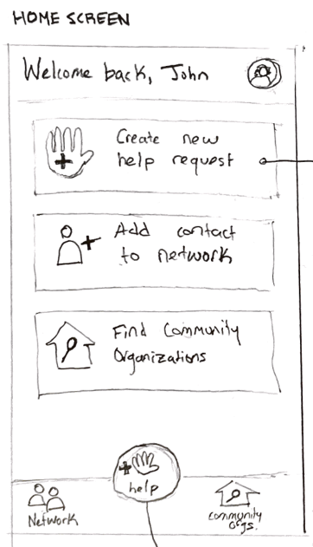
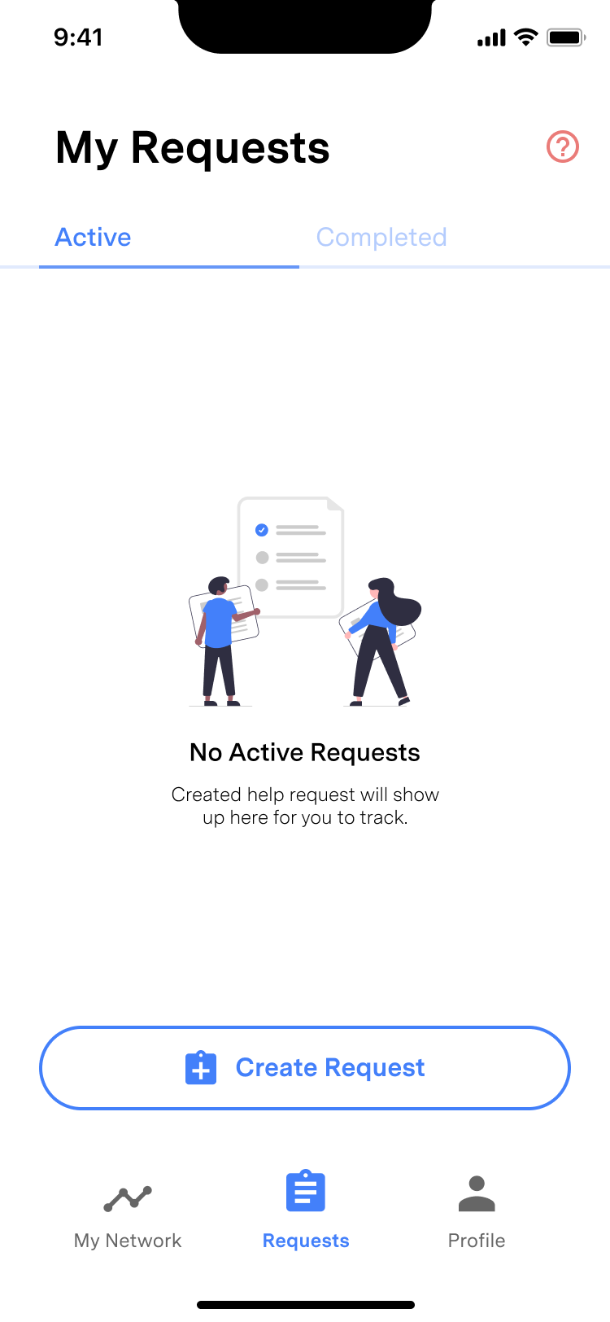
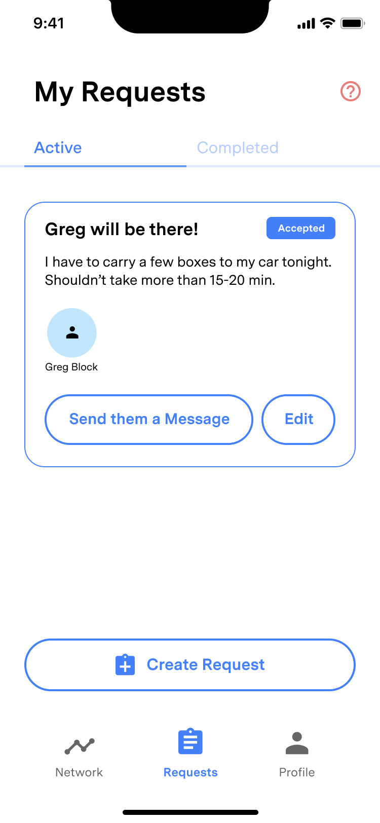
Major Design Change #1:
Home Screen Redesign
Notes:
During our low-fi testing, we found that a common pain point in our simple task flow was the redundancy between the buttons, indicating actions available to take from that screen, and the bottom taskbar of icons, also providing actions available to take from the home screen. Having two buttons that accomplished the same purpose confused testers, so when making our med-fi prototypes, we decided to do away with a stereotypical “Home Page” view altogether, and treat our default request screen as our home screen. The smaller “Create Request” button still provides explicit direction for users to be able to create a request, while preserving screen real estate so that three buttons don’t take up the majority of the view. When the user opens the app now, a scrollable list of current requests will be displayed, if there are requests to display, with the button to create a request always present.

Slide 9
Major Design Change #2:
Reformat Screen Layout (Duplicate Button Removal)
Notes:
Coupled with the issues with redundancy, the interview feedback we received indicated we needed to simplify the branching of where each task begins. To do so, we decided to reformat the layout of our app, and partition the actions effectively into network related actions, request related actions, and a third tab with profile information for the current user. The community organizations page was moved to under the network tab, which reinforces the idea that community organizations are part of one’s network, not completely separate. This was done to rectify much of the confusion we received in low-fi testing, as we got reports that it was unclear what the purpose of the center button was entirely, it was unclear what the purpose of the community organizations were, and it was unclear how the community organizations related to one’s network. The bottom tab bar now allows the user to navigate to different screens to be able to add groups or community orgs, preserving all of the functionality of the low-fi home screen, in a style more aligned with industry standards.

Slide 10
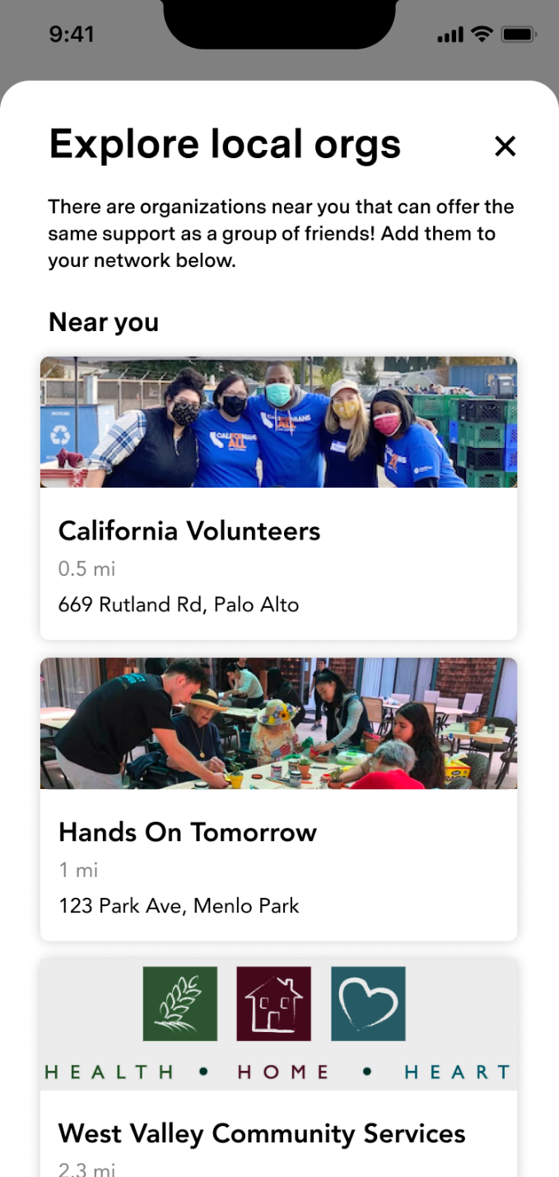
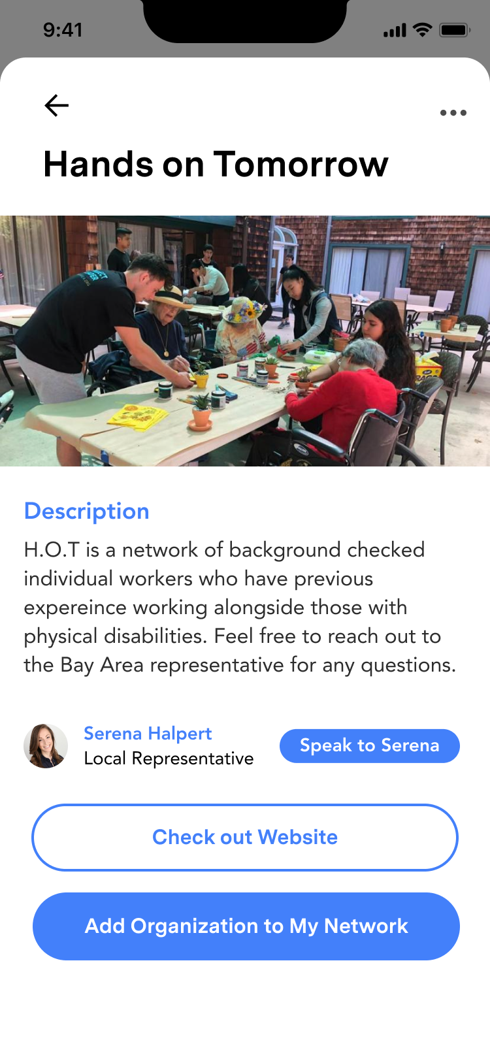
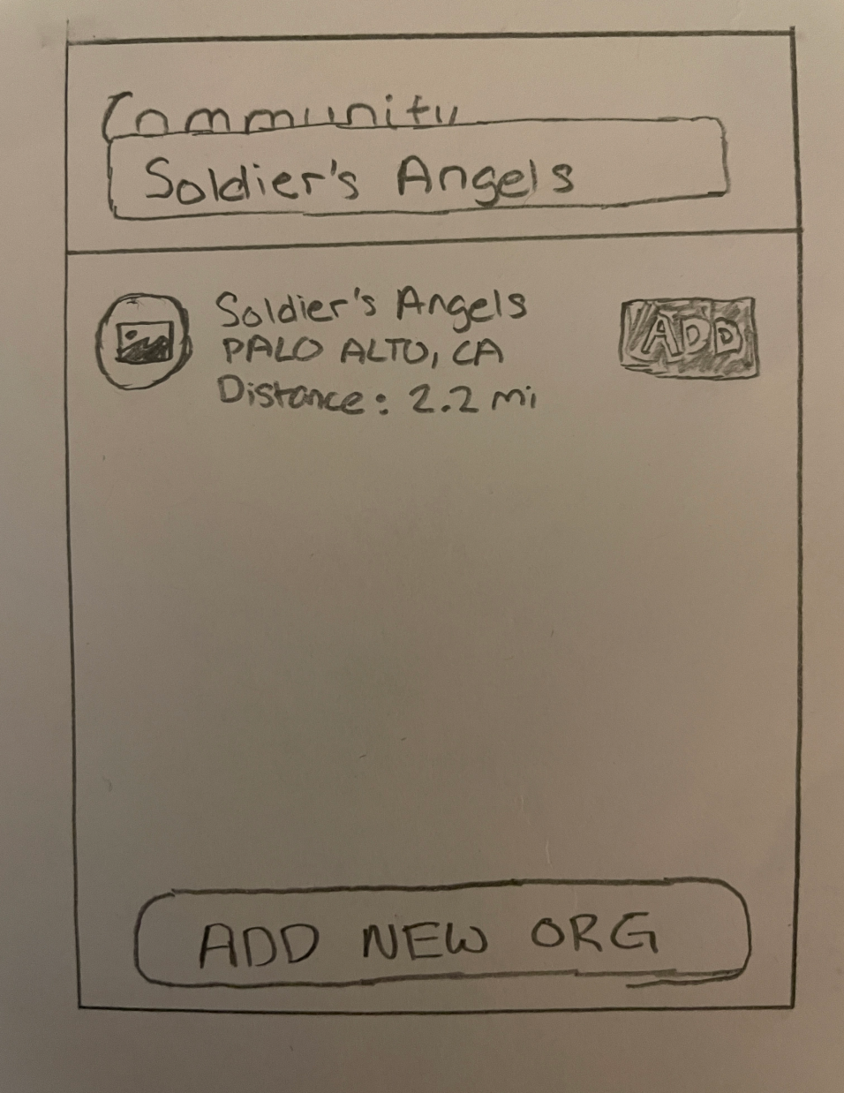
Major Design Change #3:
Added Community Org Detail Screen
Notes:
As mentioned on the previous slide, as there was confusion surrounding the presence and purpose of community orgs, in creating our medium fidelity prototype, we reconstructed our community org flow to provide more details about community organizations before they get added to your network. This was done by removing the search button for a community organization and instead displaying a feed of local organizations, with their names, address, and brief profile information. This removal turned the process of adding a community organization from adding an org the user is already familiar with, to browsing new organizations and adding them, which is more in-line with the usability goals of our app. Furthermore, on click of an organization, we now display details about the organization, as well as a point of contact, to provide more information when adding the group, so that now when a user goes to add a community organization, they are able to know what exactly the organization stands for before approaching them for help.

Slide 11
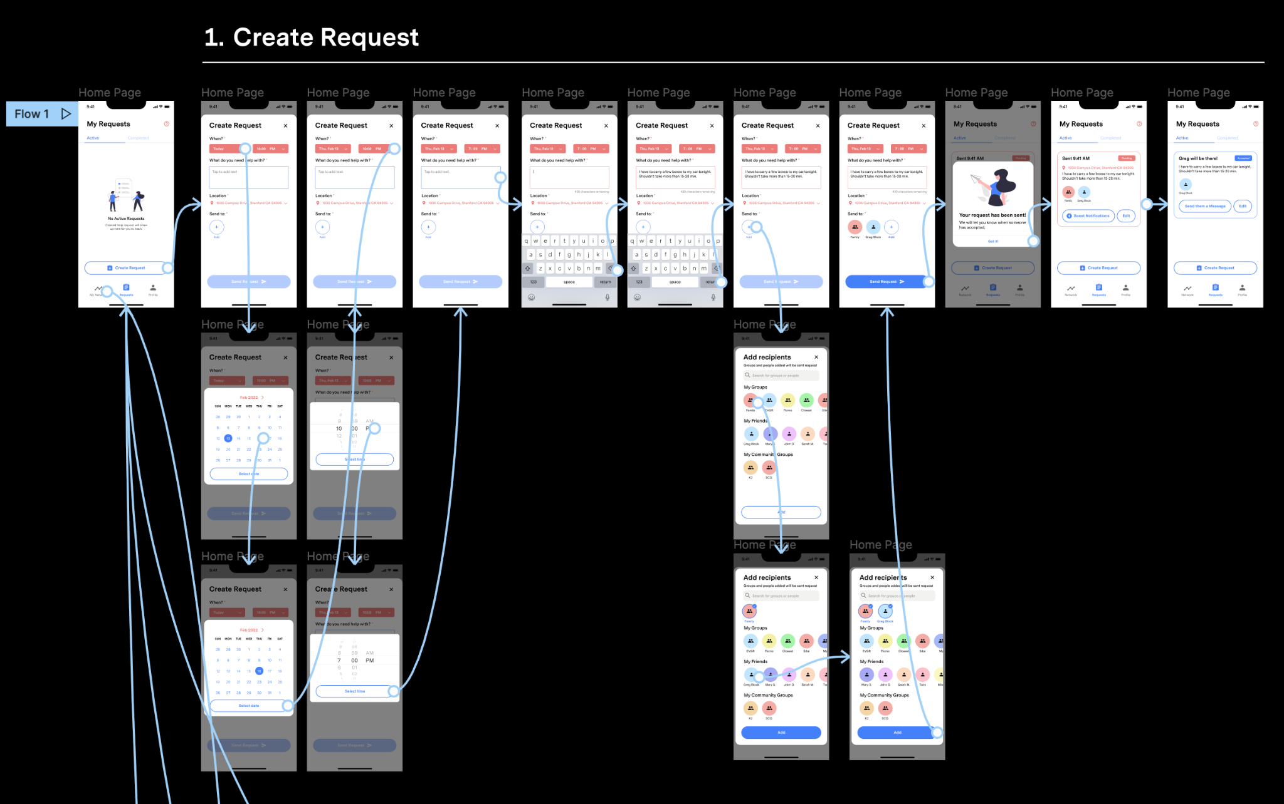
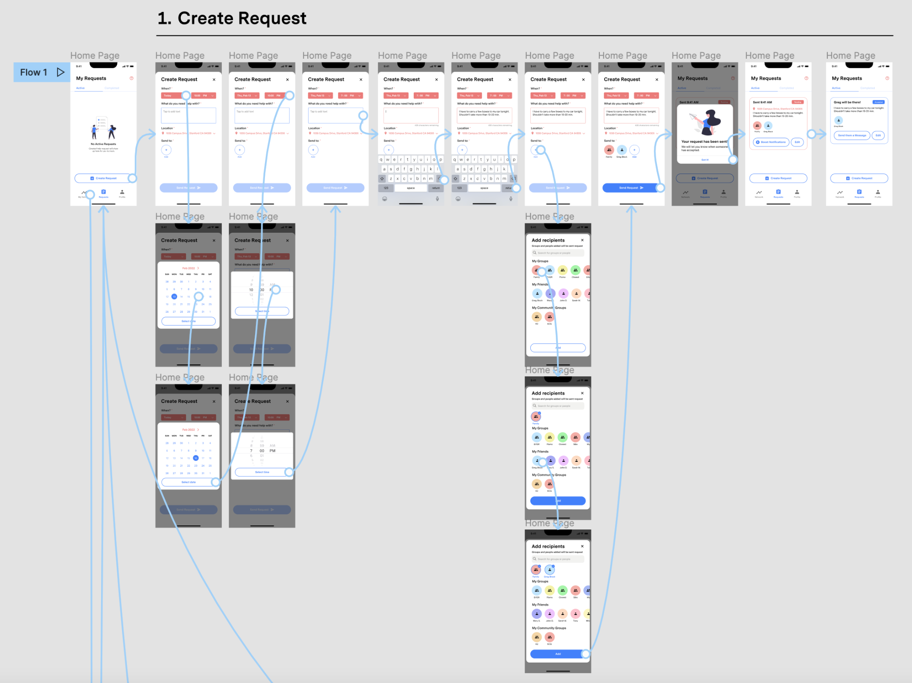

Slide 12
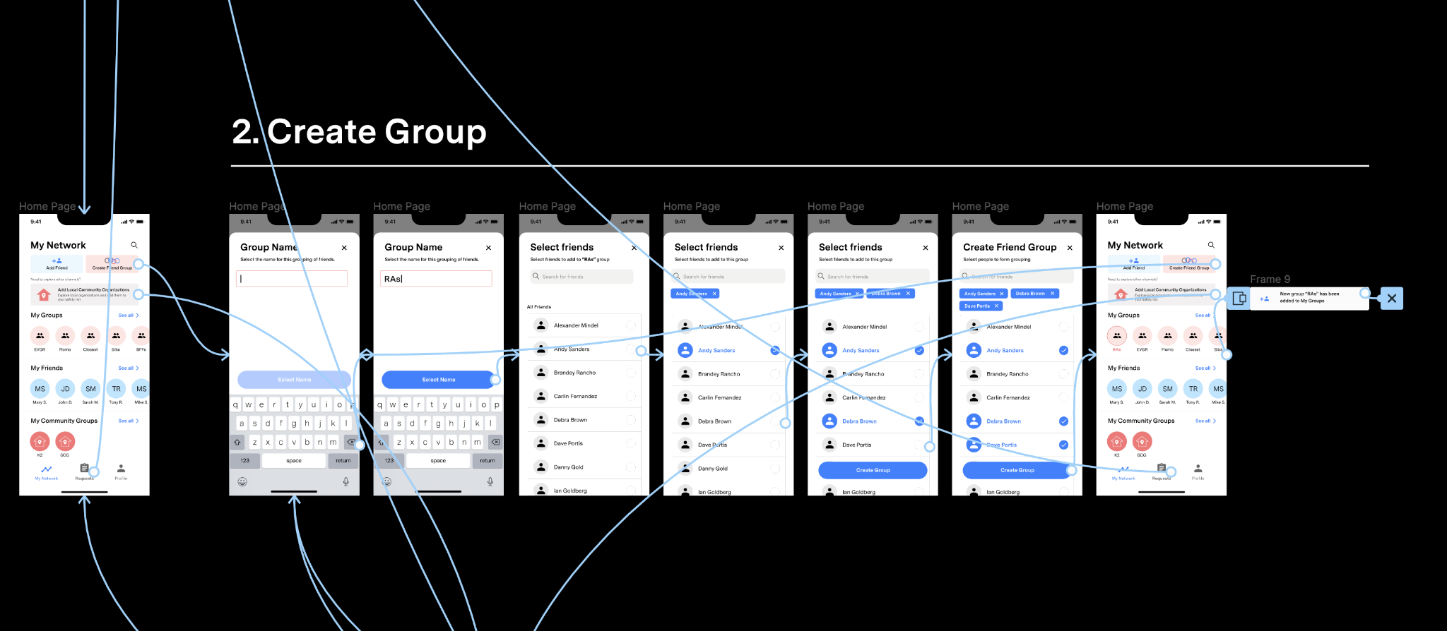

Slide 13
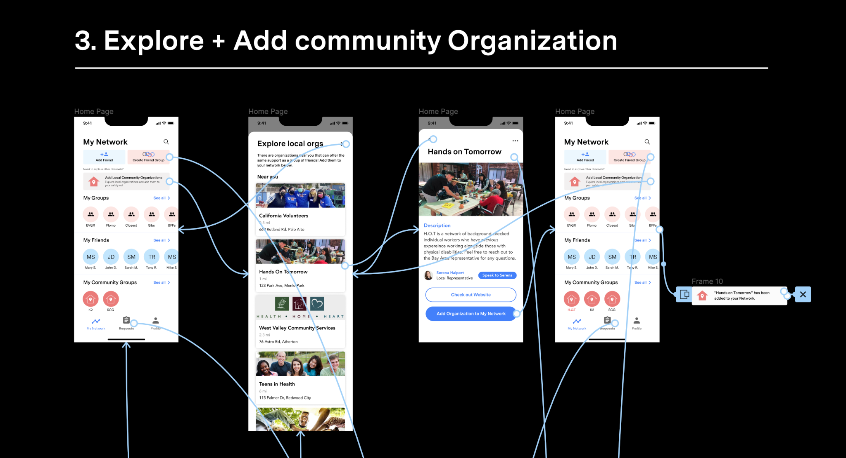

Slide 14
Prototyping Overview
Our group used figma to make our entire set of wireframes and interactive prototype
Figma made it easier to work collectively, and edit our various ideas. It was also helpful to have all of our sketches in Figma to refer to throughout the process of building.
Also we were able to start building our a small design system in terms of color, typeface, icons, and small components.
It was hard to build a fully interactive prototype with all degrees of freedom on each screen. Due to the nature of the assignment, we had to sacrifice some functionality to fully fletch out other aspects of the app, specifically our three tasks.

Slide 15
Prototyping Overview
We did make a few sections look as if you could select infinite amounts of users or groups, but it was easiest for us if we were to predetermine which users could be added in a specific order.
One Wizard of Oz technique we used was to drop in push notifications after specific tasks were completed. These notifications only appear if they finished out predetermined path, but help create a sense of feedback and processing, when in reality, no notifications were sent out to recipients. We also had to make sure that we had a screen state for an accepted request, so we transitioned to that state after any click on the screen since there are no users accepting requests yet.
Instead of having users type out a description on a keyboard, the description was populated with text after a single click. This hard-coded feature was required in figma as we couldn't have users type any description. Furthermore, it would add unnecessary time delay if users had to walk through the interface on a computer.

Slide 16


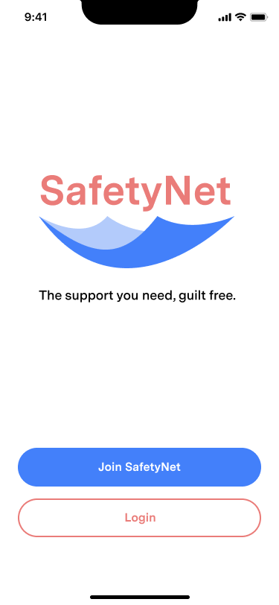

Usability Goals & Key Measurements
Usability:
Key Measurements

Slide 17
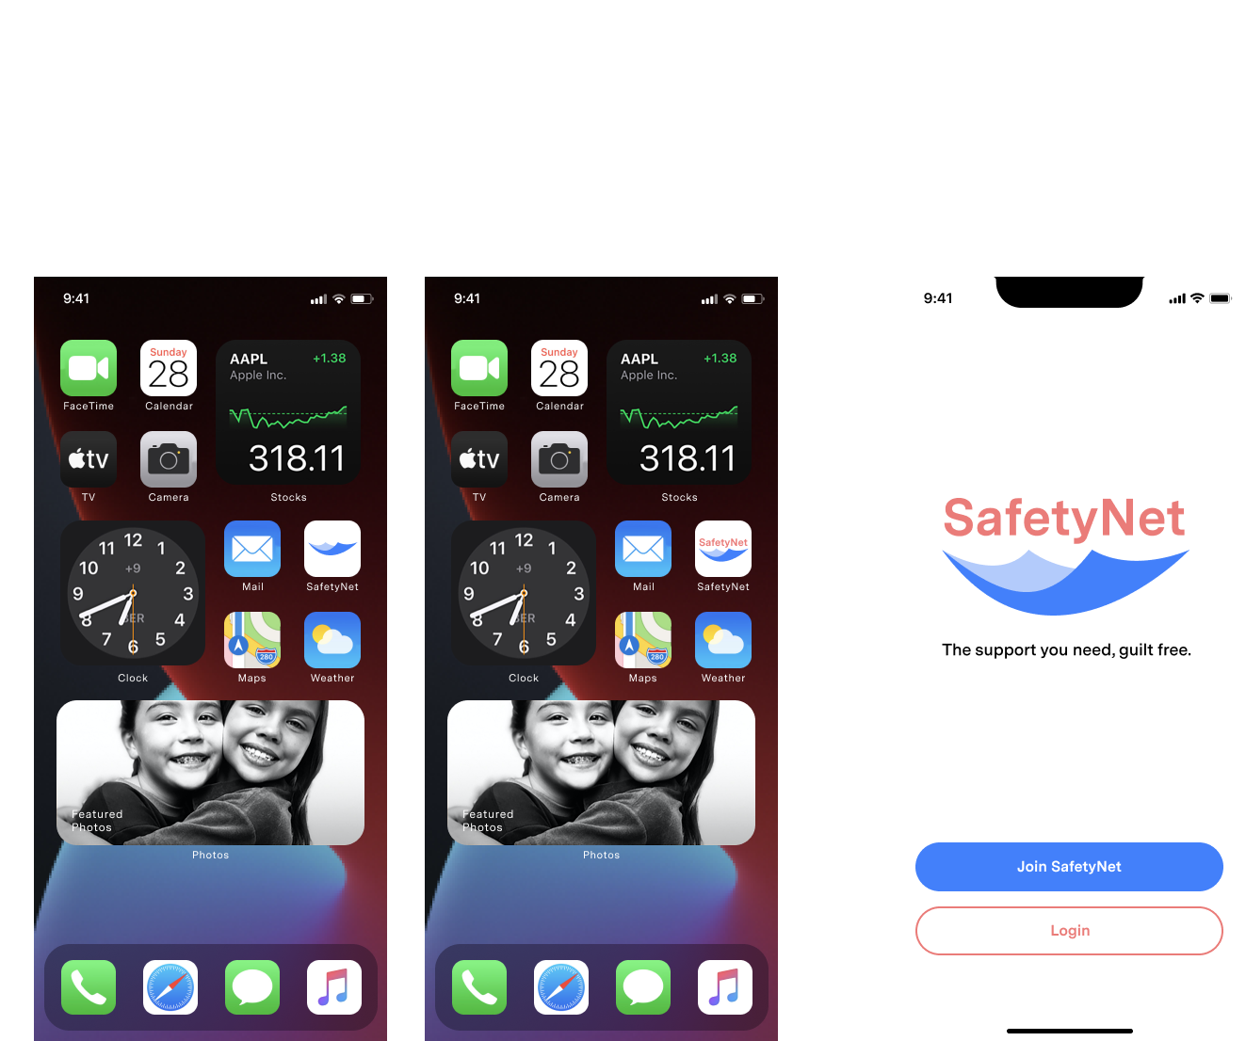
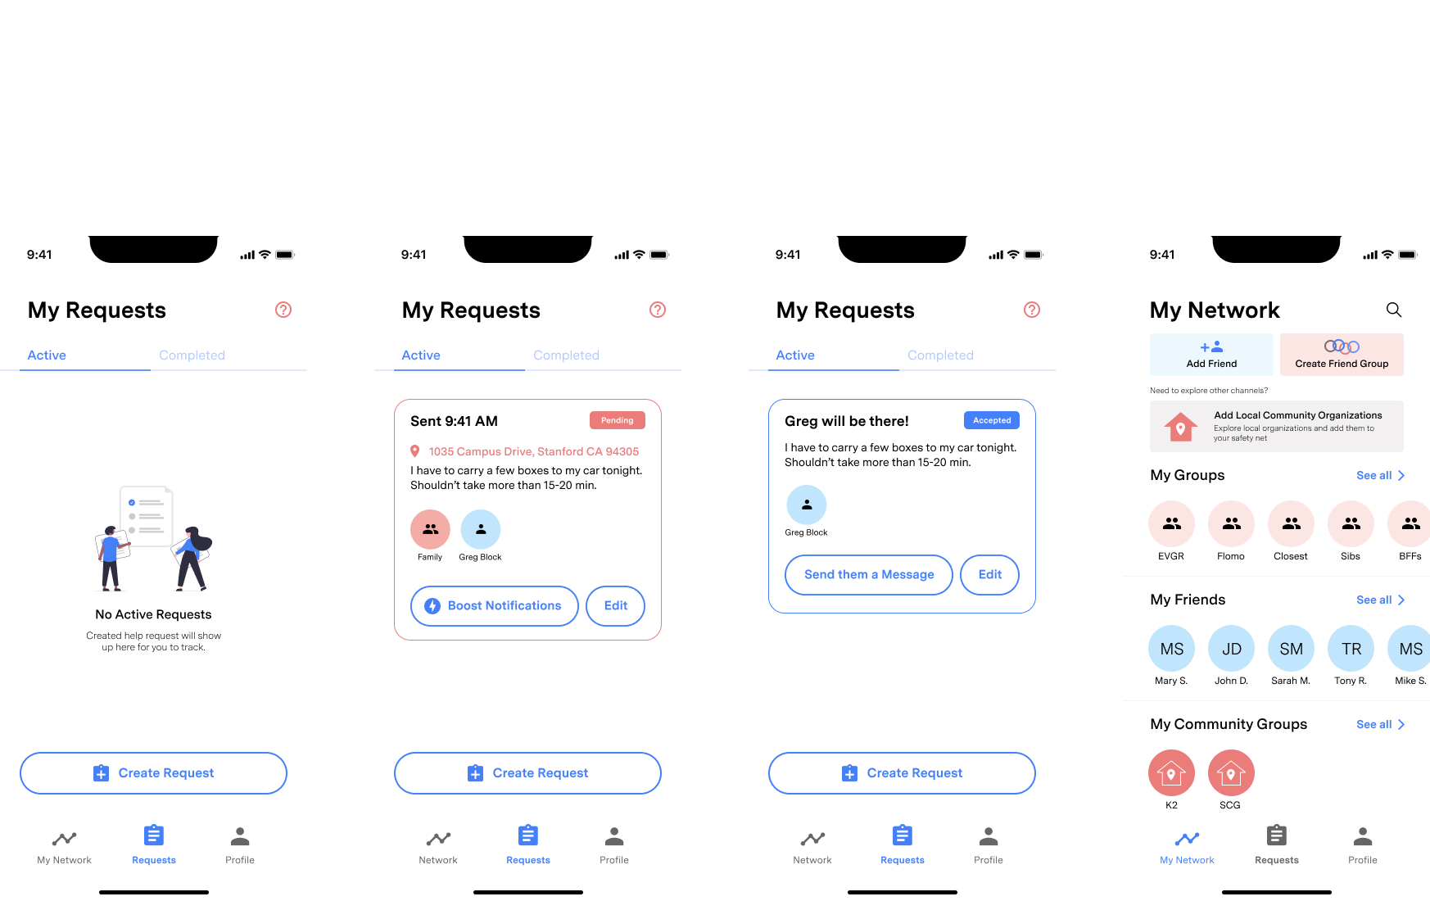
Usability Goals & Key Measurements
Usability:
Key Measurements

Slide 18
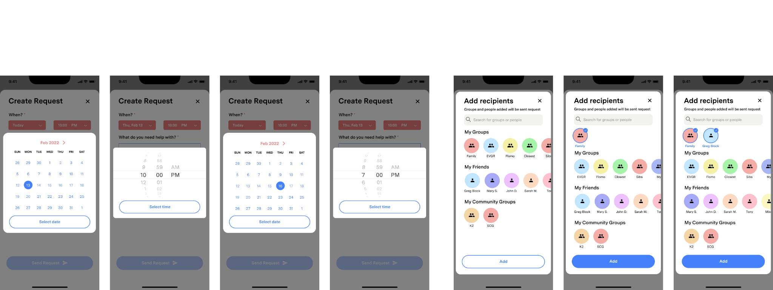
Usability Goals & Key Measurements
Usability:
Key Measurements

Slide 19
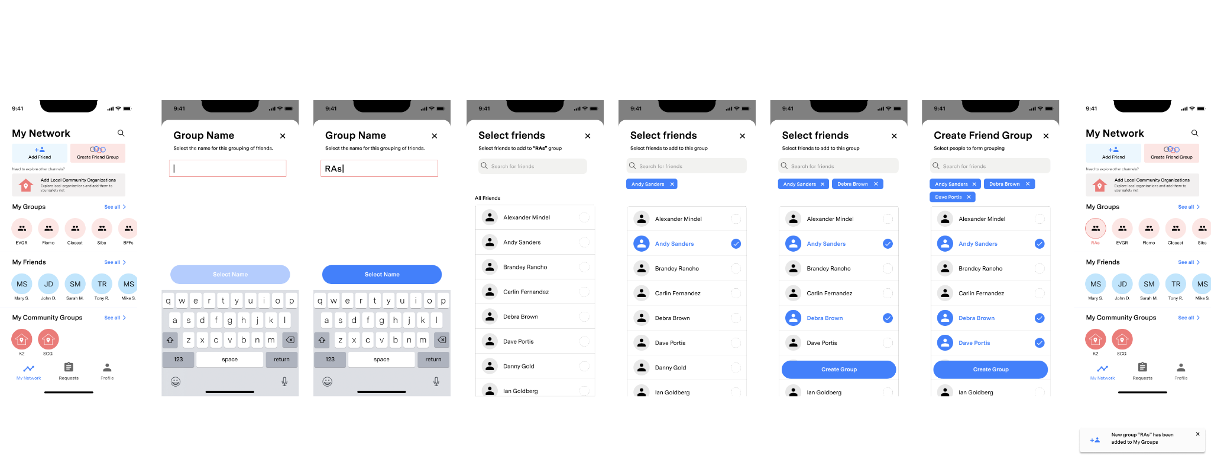
Usability Goals & Key Measurements
Usability:
Key Measurements

Slide 20
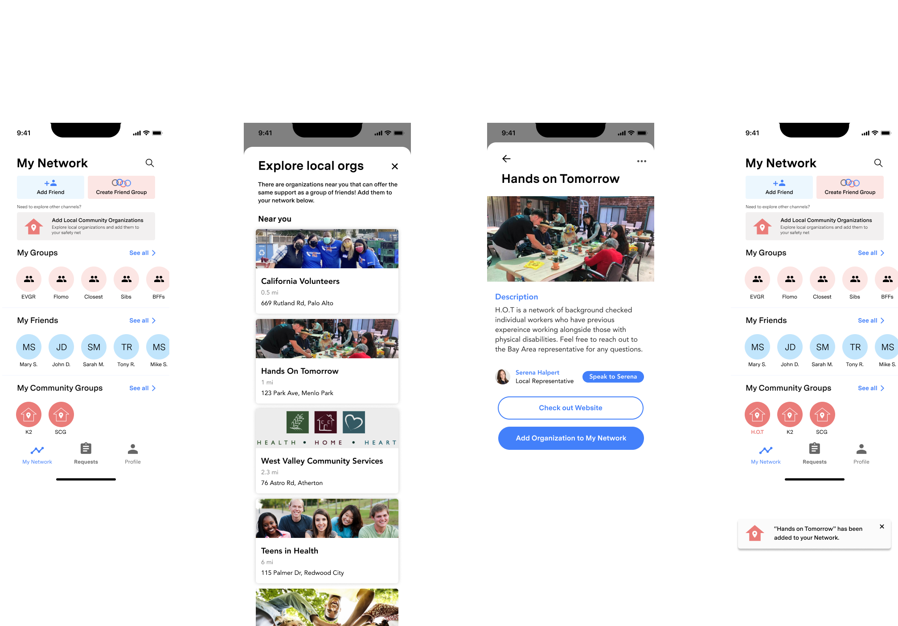
Usability Goals & Key Measurements
Usability:
Key Measurements

